Slide 1



Bird Strike Analysis Dashboard
View in Power BI
Last data refresh:
6/25/2024 7:29:41 PM UTC
Downloaded at:
6/25/2024 7:33:59 PM UTC

Slide 2
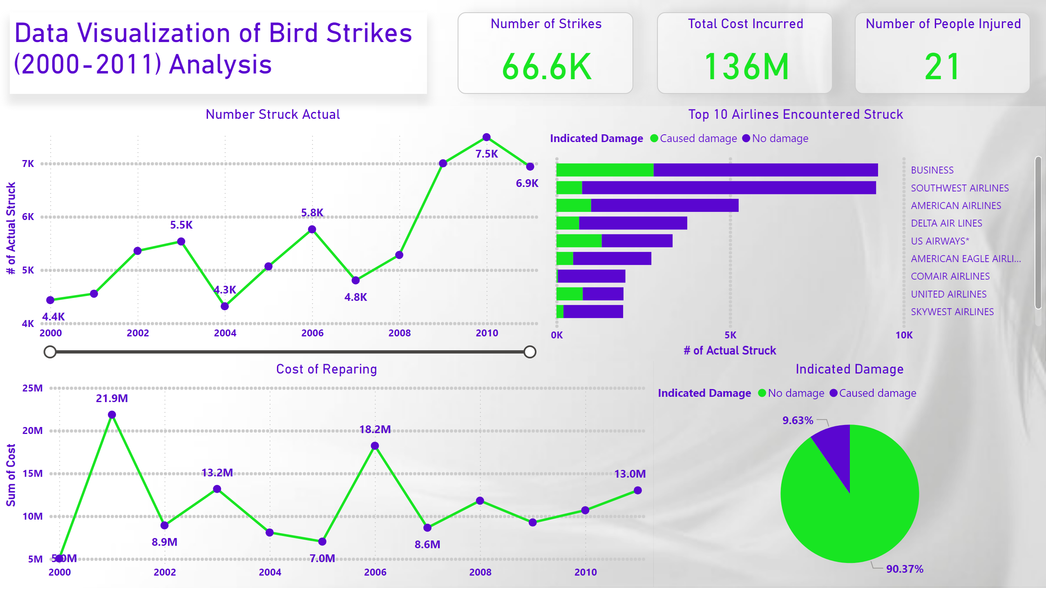
Page 1
Notes:
Number of Strikes
No alt text provided
Number of People Injured
No alt text provided
Total Cost Incurred
No alt text provided
textbox
No alt text provided
Number Struck Actual
No alt text provided
Top 10 Airlines Encountered Struck
No alt text provided
Cost of Reparing
No alt text provided
Indicated Damage
No alt text provided

Slide 3
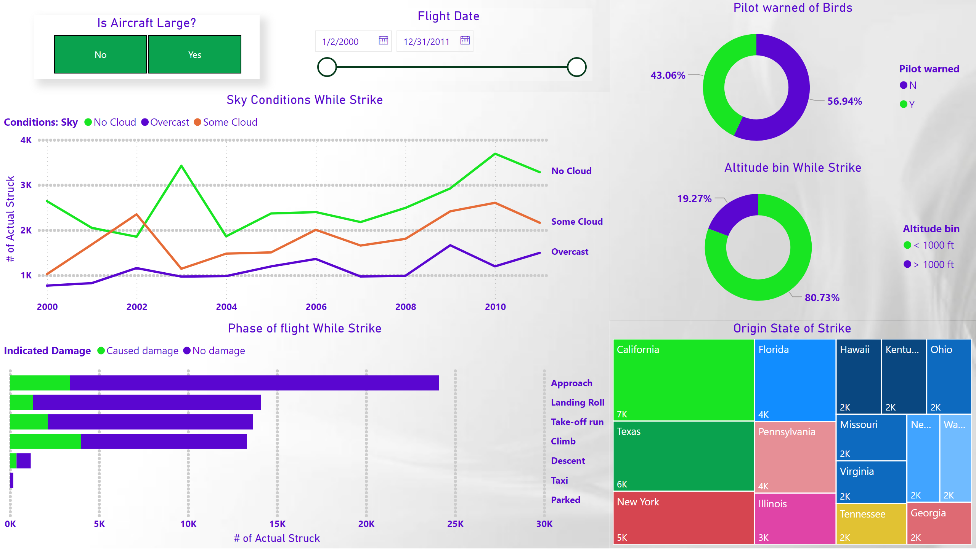
Page 2
Notes:
Altitude bin While Strike
No alt text provided
Pilot warned of Birds
No alt text provided
Sky Conditions While Strike
No alt text provided
Phase of flight While Strike
No alt text provided
Origin State of Strike
No alt text provided
Flight Date
No alt text provided
Is Aircraft Large?
No alt text provided

Slide 4
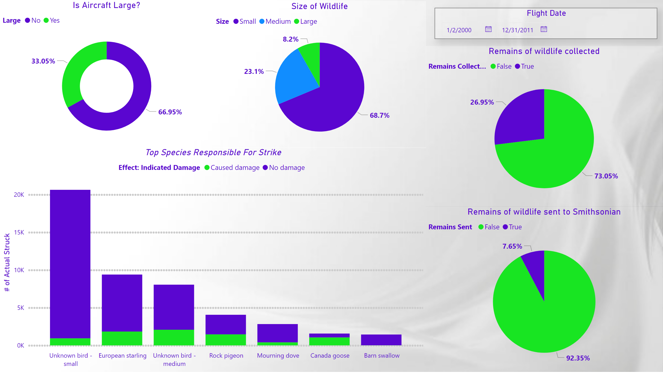
Page 3
Notes:
Remains of wildlife collected
No alt text provided
Top Species Responsible For Strike
No alt text provided
Remains of wildlife sent to Smithsonian
No alt text provided
Is Aircraft Large?
No alt text provided
Size of Wildlife
No alt text provided
Flight Date
No alt text provided

